Slide 1
Distributed Wild Bird Surveillance and Recognition System
Advisor: Craig Rupp
Client: Dr. Joseph Zambreno
Claudia Athens, Ben Simon, Pierce Adajar, Francisco Arreola

Slide 2
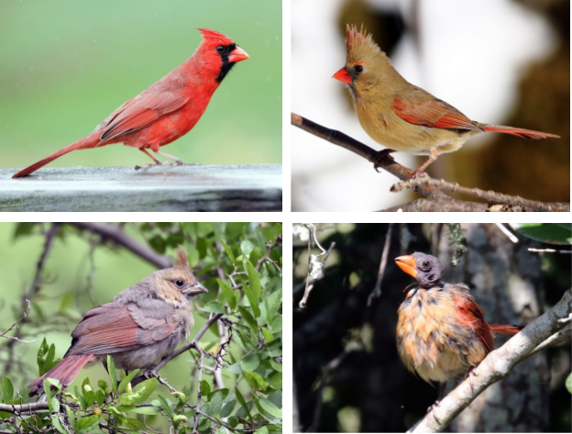
Problem Statement
Four North American Birds [Cornell Lab of Ornithology]

Slide 3
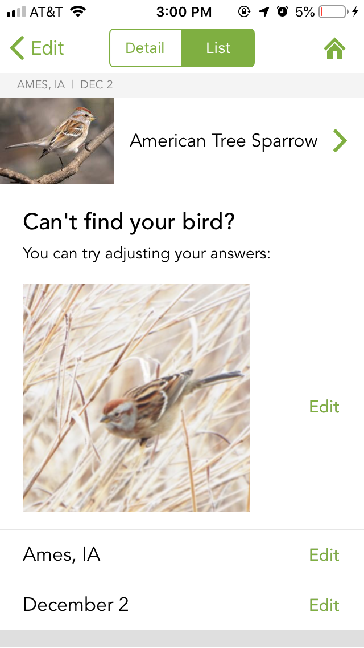
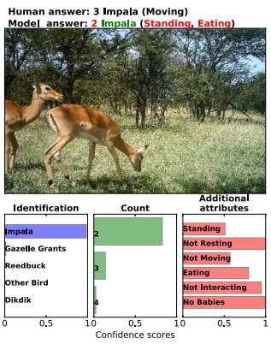
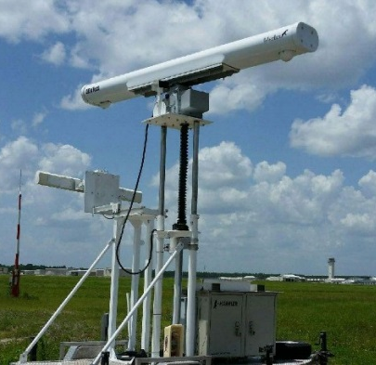
Market Survey
Radar Bird Detection System [Unmanned Systems Technology]
Merlin Bird ID
[Cornell Lab of Ornithology]
Qualifying Wild Animals
[Norouzzadeh et al.]

Slide 4
Functional Requirements
Highest quality of images
Realtime bird classification
HD video stream
User notifications for bird detection

Slide 5
Non-Functional Requirements
Budget of $1500
Portable and easy to set up
Clean user interface

Slide 6
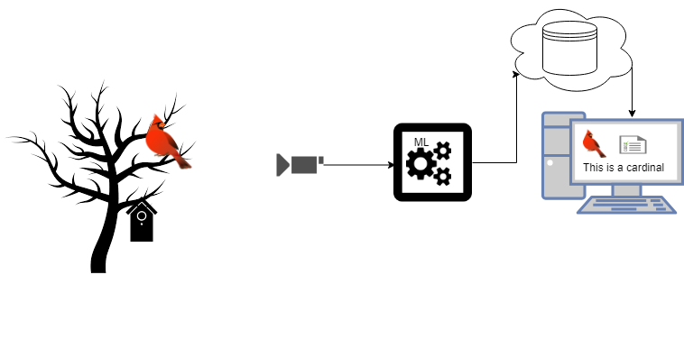
Conceptual Sketch

Slide 7
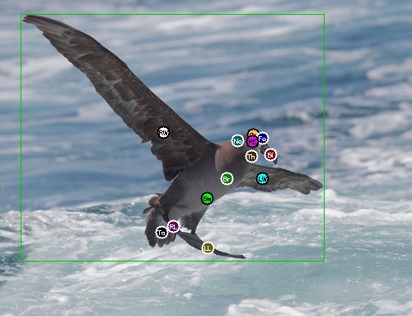
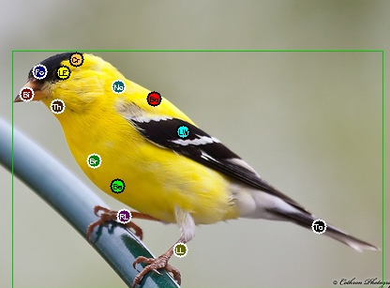
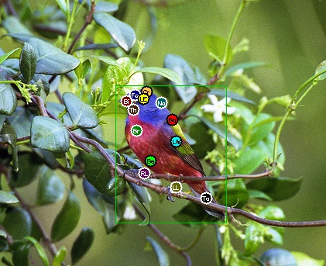
Constraints and Limitations
Computing capability of embedded system
System will be outside
Available datasets are of fine-grain detail
Black Footed Albatross [Caltech-UCSD Birds-200-2011]
American Goldfinch
[Caltech-UCSD Birds-200-2011]
Painted Bunting
[Caltech-UCSD Birds-200-2011]

Slide 8
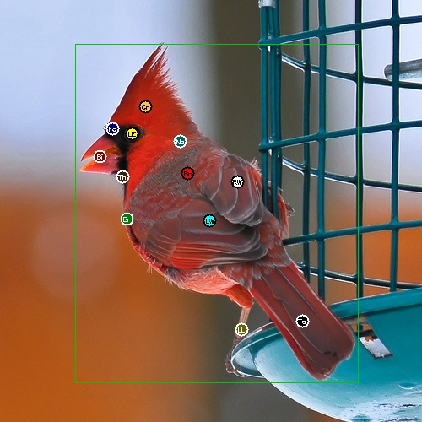
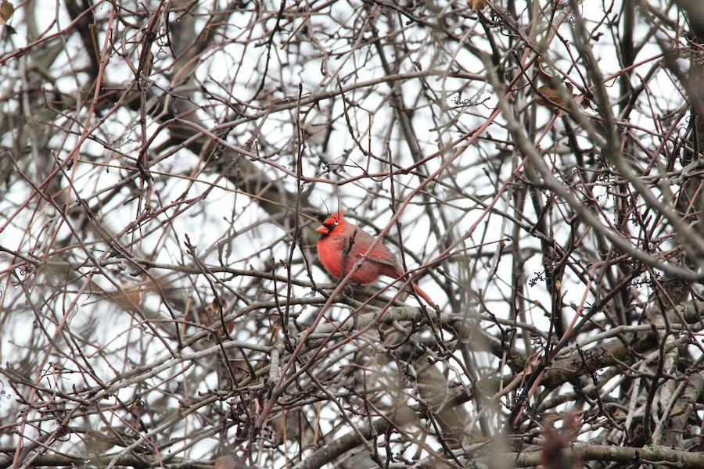
Potential Risks & Mitigation
Damage to hardware
Rain
Extreme Temp
Mitigation
Waterproof case
Endurance/real world testing
High quality image training
Real world noise
Mitigation
Additional training images
Northern Cardinal
[Caltech-UCSD Birds-200-2011]
Northern Cardinal
[Macaulay Library]

Slide 9
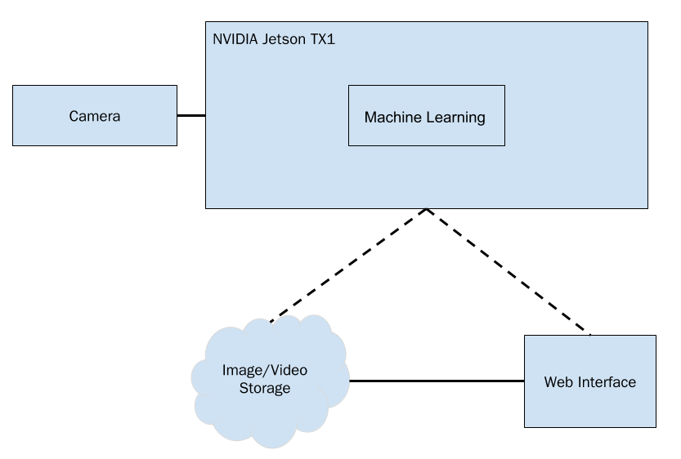
Design Diagram
Major components:
Hardware
Detection & Classification
Data Streaming & Storage
User Notifications & Frontend
Notes:
Jetson
Camera
YOLO
Modified Squeezenet
Google Cloud
GStreamer
Web Notifications
RSS Feed
Website

Slide 10
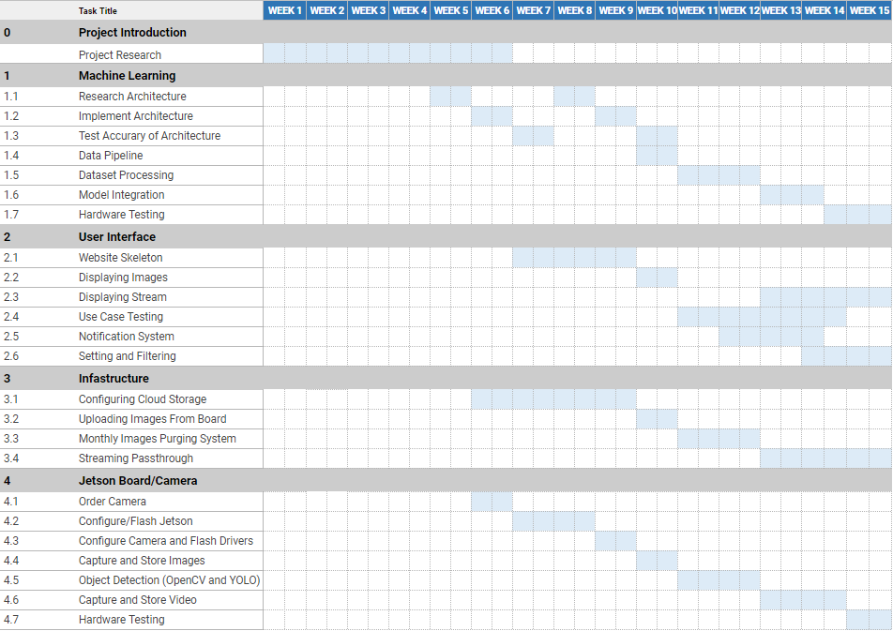
Project Milestones & Schedule Part I
First Semester Milestones:
Neural network architecture established
Base Web Interface
Configured cloud storage
Jetson TX1 flashed with software
Camera operations
Communication between all components

Slide 11
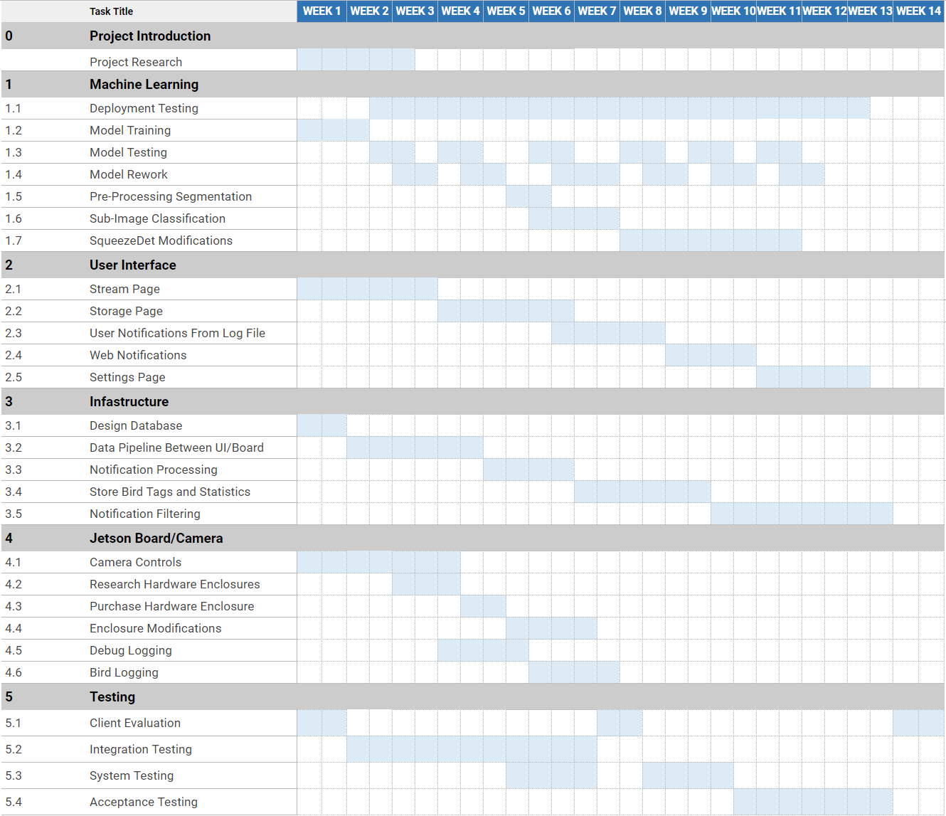
Project Milestones & Schedule Part II
Second Semester Milestones:
Model accuracy > 85%
Fleshed out web interface
User notifications
Database designed
On-board logging
Enclosure purchased and modified
Acceptance Testing

Slide 12
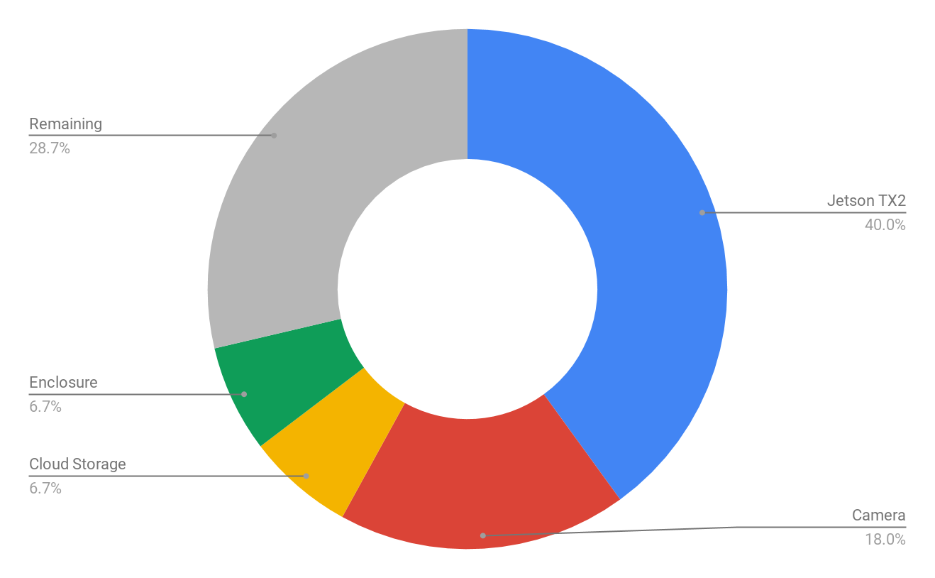
Resource/Cost Estimate
Total Budget | $1500
Jetson TX2 | $600
Camera | $270
Cloud Storage | $100
Enclosure | $100
Remaining | $430

Slide 13
Design Decomposition - Board & ML
Jetson TX1
e-CAM131_CUTX2
GStreamer-1.0
Tensorflow
SqueezeNet
Notes:
Jetson
Community Support
NVIDIA GPU - intended to be used for ML
Client provided one
e-CAM
GStreamer
Explain system diagram while explaining GStreamer use
Tensorflow
Iteration - pythion

Slide 14
Design Decomposition - Web & Cloud
Flask
Angular
Web Notification API
Google Cloud Platform
Notes:
GCP
Selected out of major cloud providers due to cost / needs fitting
Pricing model structured - lowest tier is cheapest
Flask
Delivers resources
RESTful Service for delivering web pages using python
Delivers HTML / CSS / etc.
Delivers images as necessary
Angular
Shows delivered resources

Slide 15
Test Plan - Module Test Plan
Hardware
4k picture can be taken successfully
Detection & Classification runs within timing constraints
Meets IP-43 weather-proofing constraints
ML
Images can be classified with high accuracy
Model runs within timing constraints
Web
Stream can be accessed and is of high quality
User interface is easy to use
Cloud
Images can be stored & retrieved
Notes:
Per our client’s specification: Detection - 2-3fps
1080p @ 30fps

Slide 16
Test Plan - Holistic
Bird Comes into Frame
Bird is successfully detected
Image is classified
Image is uploaded to cloud
User is notified
Detection algorithm detects large “bird-like” object
Board saves frame
Frame is passed to classifier
Neural Net finds most likely classification
Image is labeled with classification
Labeled image is uploaded to cloud
Web frontend displays image
Bird classification is indexed by cloud service
User is notified via web notification
Stream is available to be viewed
Notes:
System is outside
Camera feeds image into Jetson
NN detects bird
NN classifies bird

Slide 17
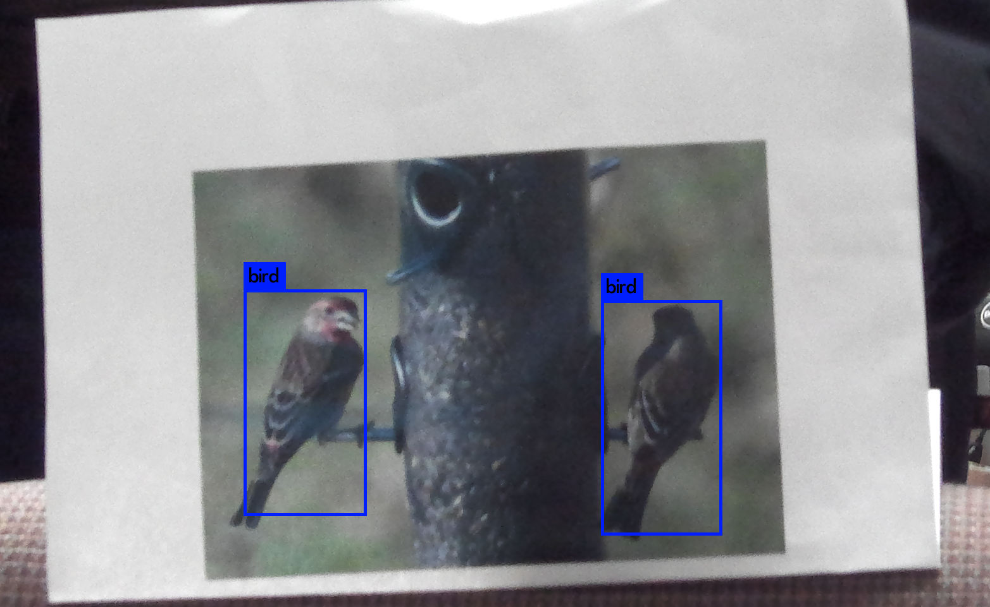
Prototype Implementations
Working Camera
Uploading images to cloud
Showing images on website
Toy model
~10% accuracy
Notes:
Working camera
Set up drivers on the jetson to properly interface with the camera and take pictures.
Basic object detection
We worked on setting up a pretrained model for object detection. We
We’ve made prgess across the 4 major areas od our project.

Slide 18
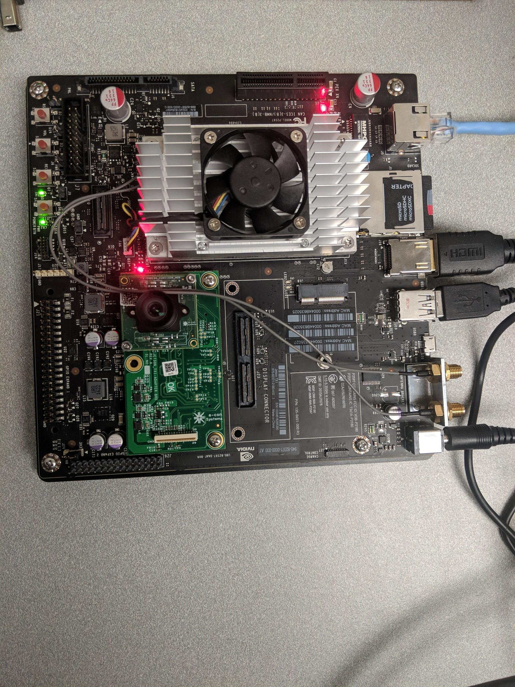
Current Project Status
SqueezeNet Based Model
GStreamer based streaming
Gather data from client site
Bird detection
YOLO v3 for object detection
Add images to validation set

Slide 19
Task Responsibility/Contributions of Each Member
Pierce Adajar - ML Lead
Toy ML model
ML Architecture
Training data processing
Francisco Arreola - Infra. Lead
Cloud storage (GCP)
Video streaming (GStreamer)
Claudia Athens - Sys. Int. Lead
Configuring Jetson TX1/e-CAM camera
Camera image/video capture
Object detection with YOLO
Ben Simon - UI/UX Lead
Setting up web server (flask)
UI design

Slide 20
Plans for Next Semester
Improve classification accuracy
Refining architecture
Extensive logging
Notification System
Improving web interface
Finalize end point system
Field testing

Slide 21
Questions?

Slide 22
Appendices

Slide 23
First Semester Gantt Chart

Slide 24
Second Semester Gantt Chart

Slide 25
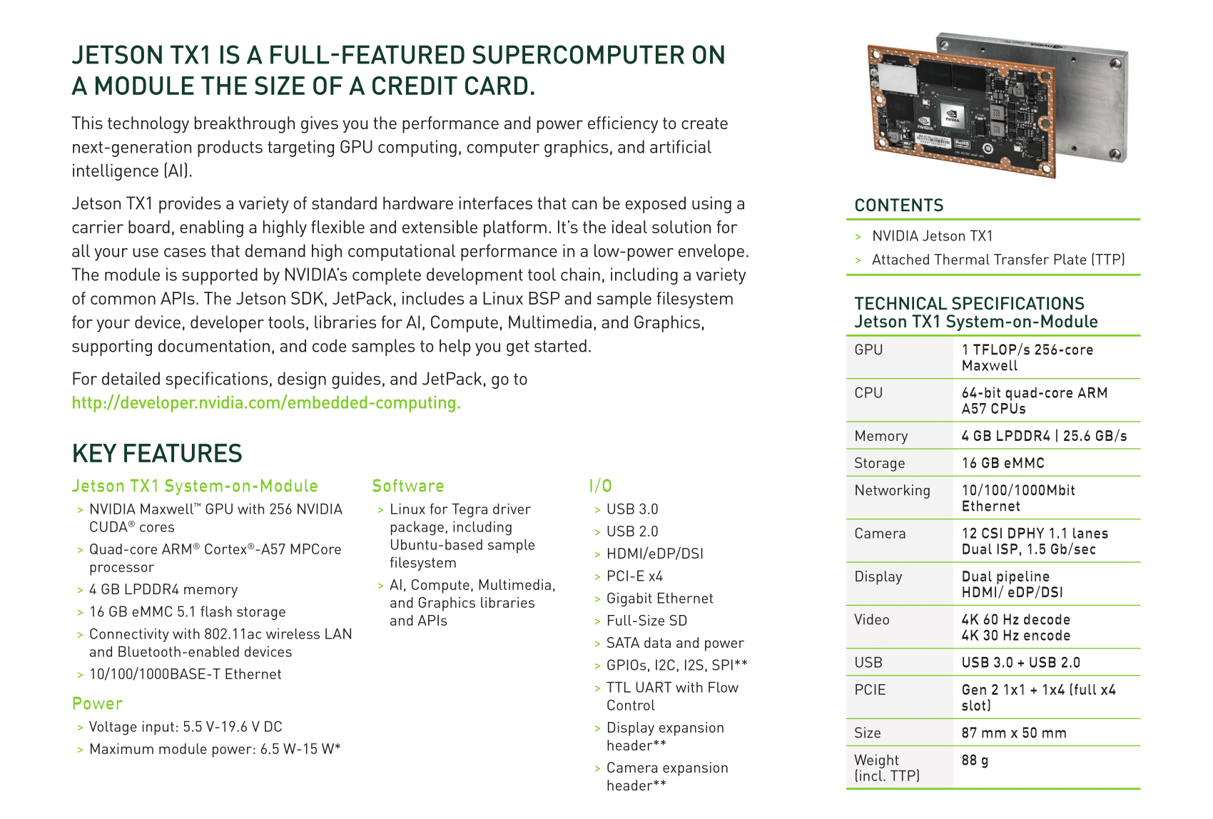
Jetson TX1 Specifications
Jetson TX1 [NVIDIA]

Slide 26
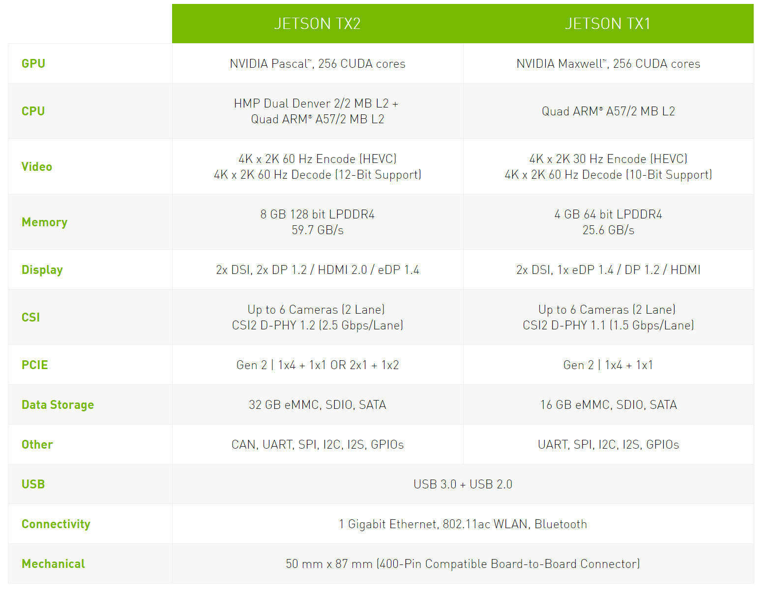
Jetson TX1 vs. Jetson TX2
Jetson TX1/TX2 Specs [NVIDIA]

Slide 27
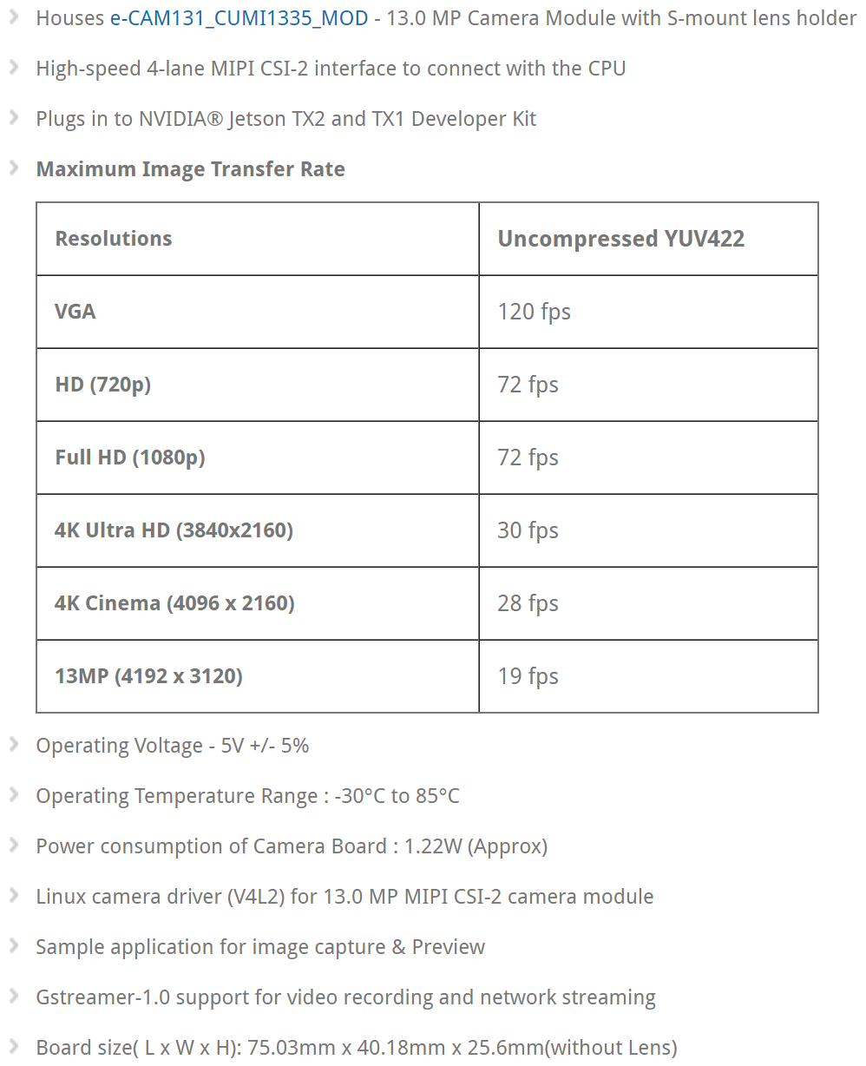
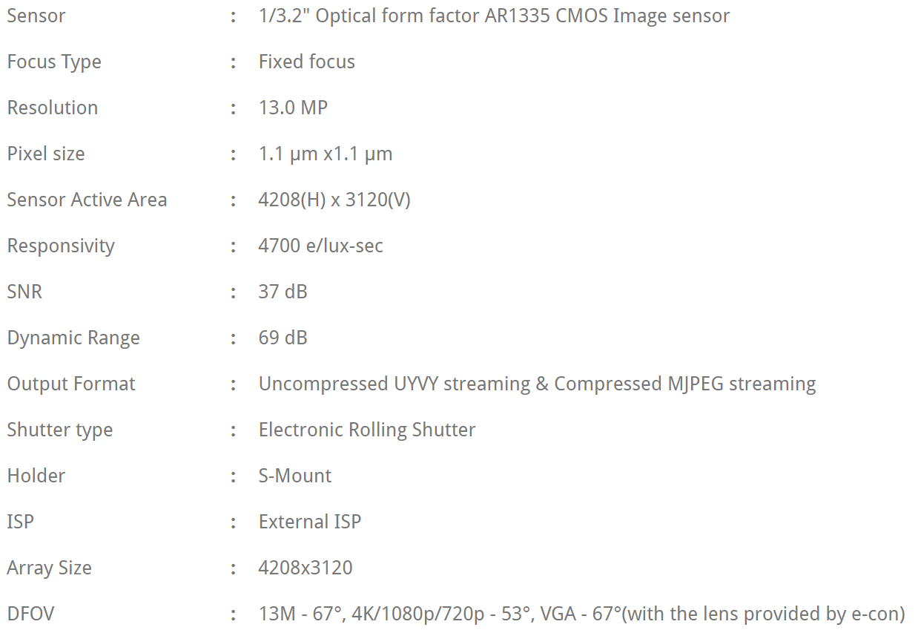
e-CAM131_CUTX2 Specifications

Slide 28
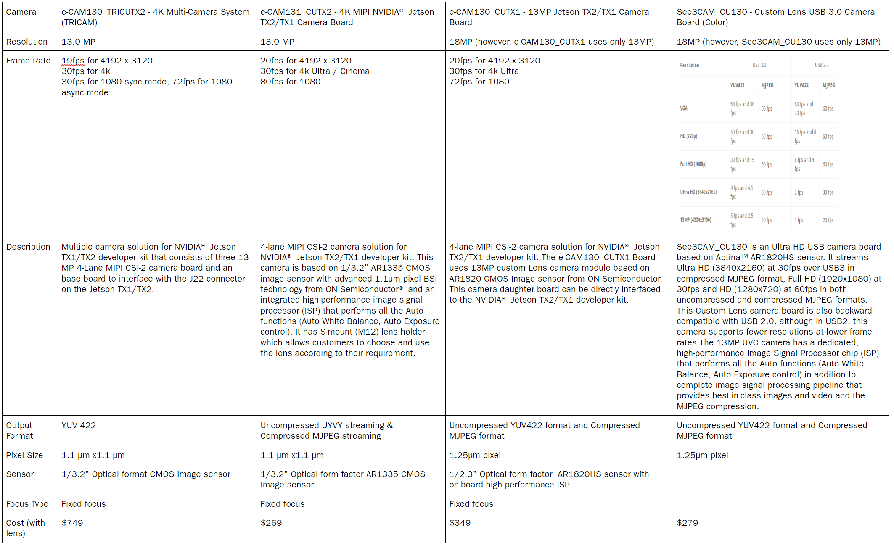
Camera Options

Slide 29
Web Page Mockup

Slide 30
Neural Network Architecture

Slide 31
You Only Look Once (YOLO)

Slide 32
International Protection (IP) Code
Solid Particle Protection [IP Code]

Slide 33
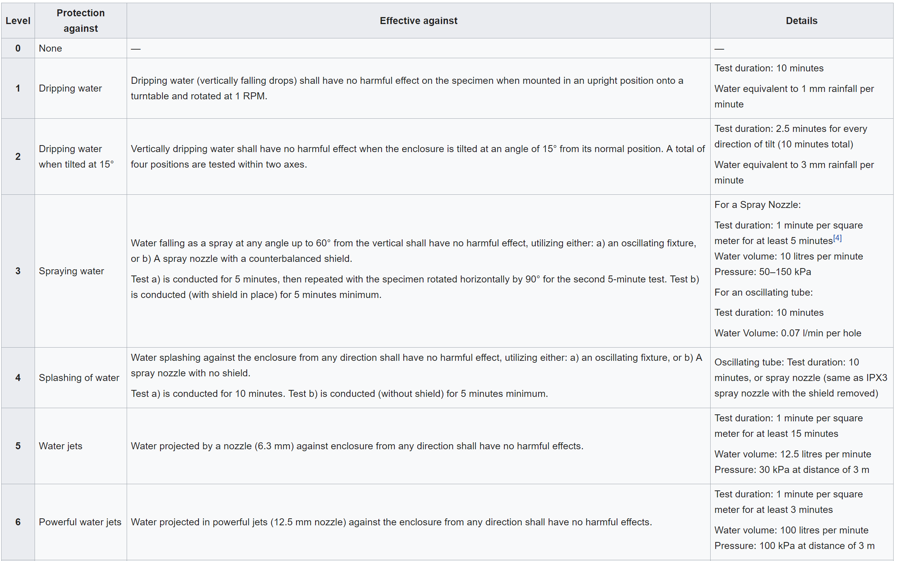
International Protection (IP) Code Part II
Liquid Ingress Protection [IP Code]

